Slide 1
Battle of Neighborhoods Coursera Capstone

Slide 2
Contents
Introduction
Data
Problem Statement
Methodology
Results
Discussion
Conclusion

Slide 3
Introduction
This project explores the best locations for opening an Italian restaurant in Brooklyn, New York.
Brooklyn is the largest borough by population.
New York has the largest population of Italians at 3.1 million people.
Audience can be anyone who is looking to open or invest in an Italian restaurant.

Slide 4
Data
New York City dataset that contains Borough, Neighborhoods along with their latitudes and longitudes.
Data Source: https://cocl.us/new_york_datase
Italian restaurants in Brooklyn neighborhood of New York City.
Data Source: Foursquare API

Slide 5
Problem Statement
What will be the best location for an Italian restaurant in Brooklyn, NY?
Which neighborhood is the best for one who is looking out to open an Italian restaurant in Brooklyn, NY?

Slide 6
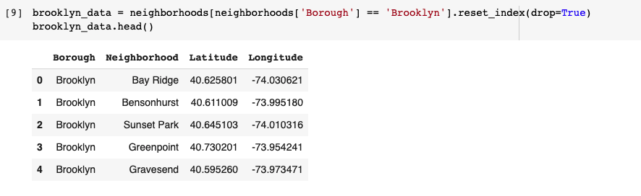
Methodology
Collect the New York City data and get all the venues present in the Brooklyn Neighborhood using the Foursquare API.

Slide 7
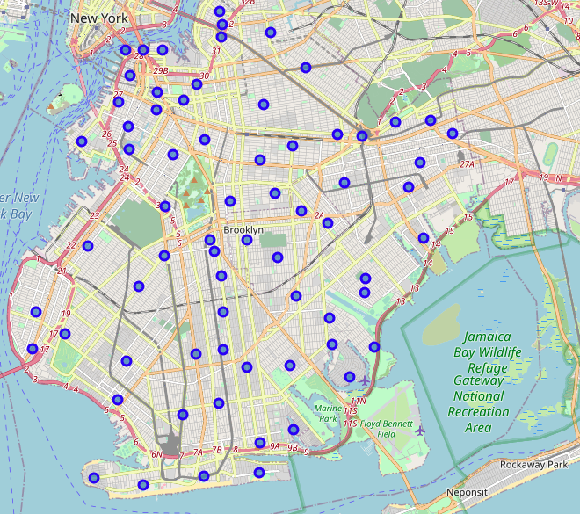
Used geocoder to get the geographical coordinates of Brooklyn and created a map for Brooklyn using the folium library Map function.

Slide 8
Filter out all the venues that are Italian restaurants.
We will do one hot encoding for getting dummies of the venue category and in the end extract only the Neighborhood and Italian Restaurant column for further analysis.

Slide 9
Analyzing the data using K-means Clustering and visualizing the neighborhoods with the number of Italian restaurants present.
Calculated the best value of K in order to cluster the neighborhoods and then visualize them.

Slide 10
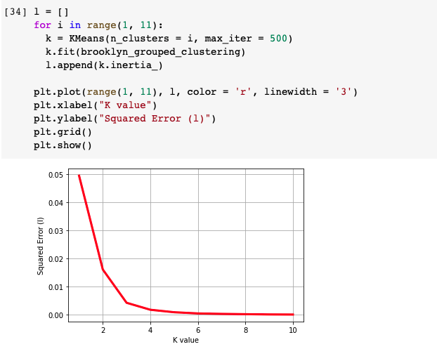
As the K value is 3, we’ll be clustering the neighborhoods of Brooklyn into 3 different clusters say Cluster 0 ,1, and 2.

Slide 11
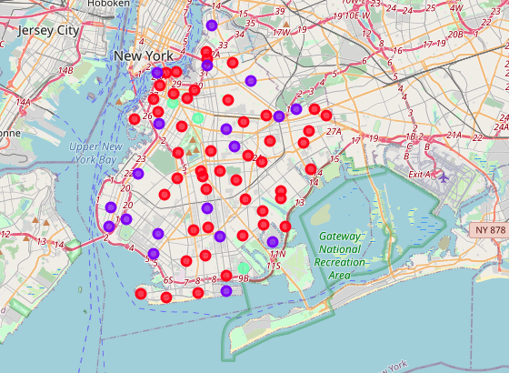
Brooklyn map with 3 clusters

Slide 12
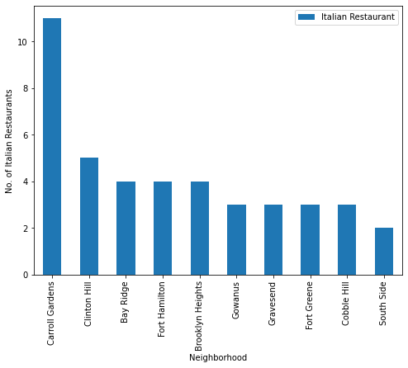
Bar graph to visualize the number of Italian restaurants located in each neighborhood of Brooklyn

Slide 13
Results
Carroll Gardens neighborhood has the highest number of Italian restaurants.
Bay Ridge neighborhood has a high density of Italian restaurants.
I will open the restaurant in Gerriston Beach. As it'll become a beachside restaurant and there is also a shopping outlet close by which leads to more profits sooner.

Slide 14
Discussion
Gerriston Beach will provide the least competition for an upcoming Italian restaurant as there is a shopping mall close to this neighborhood.
The analysis I did is completely relied on the data provided by Foursquare API and using K-means clustering.
In this analysis, there are number of factors that play a major role such as the number of customers, land value, distance.
The results might vary if we had used some other clustering techniques like DBSCAN.

Slide 15
Conclusion
Finally, to conclude this project, we have got a small glimpse of how a real-life Data science project looks like
I have used some frequently used python libraries to handle loading the JSON file, plotting graphs, and performing other exploratory data analysis.
As a final note, all of the above analysis is based on the Foursquare data.

Slide 16
THANK YOU

